Slide 1

OLA Monthly Performance Review
July 2024 Overview: A comprehensive look at our operational and financial metrics.

Slide 2

Executive Summary: July 2024 Performance
Total Bookings
99,952 rides initiated
Succeeded Bookings
62,053 rides completed
Cancellations
28,073 rides cancelled
Cancellation Rate
28.09% of total bookings

Slide 3

PERFORMANCE DEEP DIVE
Overall Booking Status Distribution
Key Insights
Over 60% of bookings successfully completed.
Driver cancellations are a significant factor, contributing to nearly 18% of lost bookings.
Driver not found instances highlight potential supply-demand imbalances in certain areas.
Customer cancellations require further investigation into pre-ride experience.
Success
Cancelled by Driver
Cancelled by Customer
Driver Not Found

Slide 4
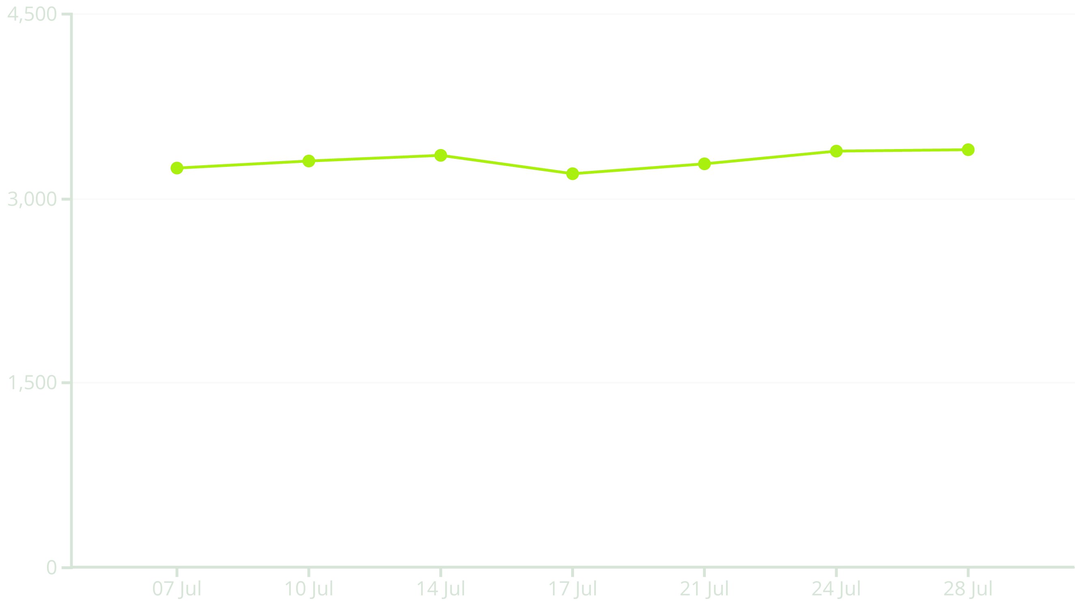
OPERATIONAL INSIGHTS
Ride Volume Trends: July 7th - July 28th
Daily ride volume shows significant fluctuations, peaking towards the end of July. Analyzing specific events or promotions during these periods could provide further insights into demand drivers.

Slide 5





CANCELLATION ANALYSIS
Top Cancellation Reasons by Customer
Driver Not Moving
Driver Asked to Cancel
Change of Plans
19.83% of customer cancellations
30.3% of customer cancellations
25.39% of customer cancellations
AC Not Working
Wrong Address
14.87% of customer cancellations
9.6% of customer cancellations

Slide 6

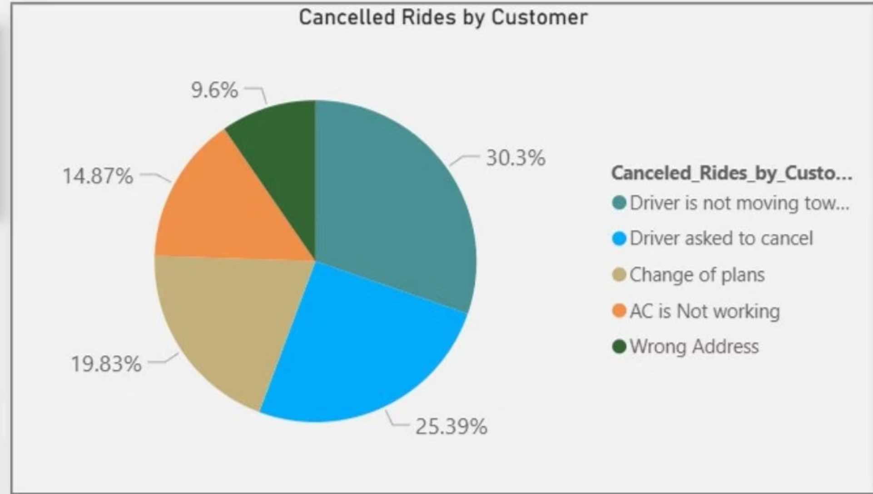



CANCELLATION ANALYSIS
Top Cancellation Reasons by Driver
Personal/Car Issue
35.48% of driver cancellations
Customer Related Issue
29.34% of driver cancellations
Customer Health Concern
19.86% of driver cancellations
Capacity Exceeded
15.32% of driver cancellations

Slide 7
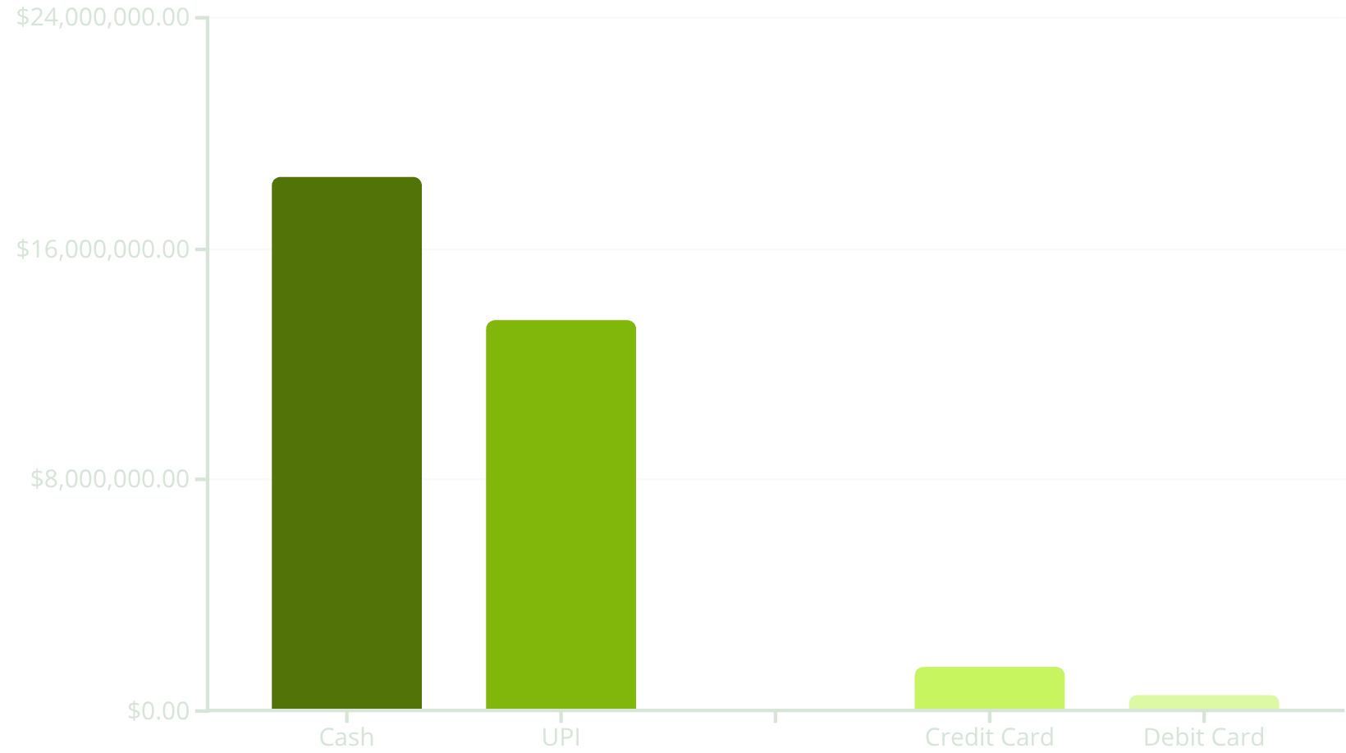
REVENUE OVERVIEW
Total Booking Value & Revenue by Payment Method
₹34 Million
Total Booking Value
Generated from all ride types in July.

Slide 8
REVENUE & DISTANCE BY VEHICLE TYPE
Performance Across Ride Categories
Prime Sedan
8.06M
5.07M
25.00
228K
Prime SUV
7.68M
4.72M
24.91
217K
Prime Plus
7.83M
4.88M
25.01
221K
Mini
7.75M
4.75M
24.99
220K
Auto
7.82M
4.87M
10.04
89K
Bike
7.76M
4.84M
24.93
221K
E-Bike
7.93M
4.90M
25.14
224K
Prime Sedan and E-Bike lead in total distance, while Auto shows significantly shorter average distances, indicating its use for shorter trips.

Slide 9



CUSTOMER & DRIVER FEEDBACK
Ratings Across Vehicle Types
Driver Ratings
Prime Sedan: 3.99
Prime SUV: 4.01
Prime Plus: 4.00
Mini: 3.99
Auto: 4.00
Bike: 3.98
E-Bike: 4.01
Customer Ratings
Prime Sedan: 4.00
Prime SUV: 4.00
Prime Plus: 4.01
Mini: 4.00
Auto: 4.00
Bike: 3.99
E-Bike: 3.99
Both driver and customer ratings remain consistently high across all vehicle types
, indicating overall satisfaction.

Slide 10
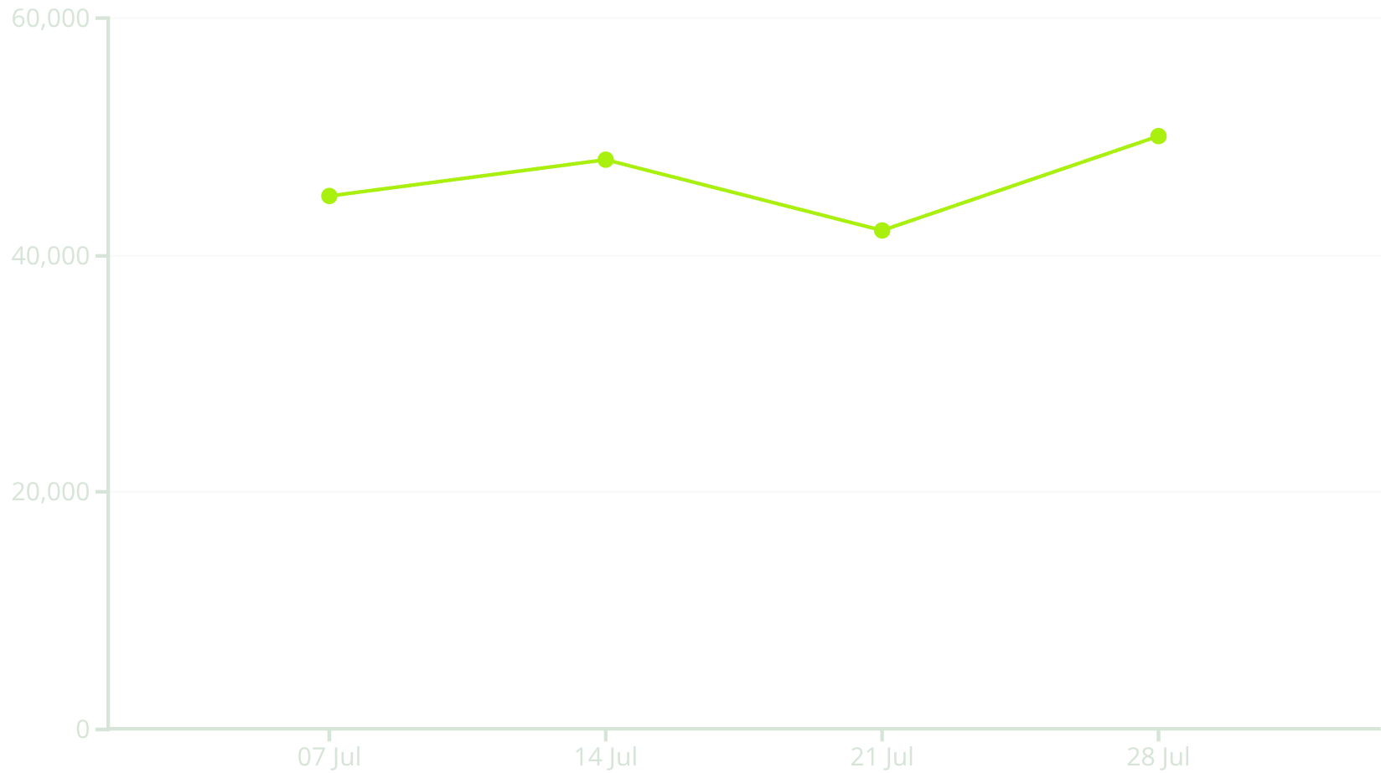
TOP CUSTOMERS & RIDE DISTANCES
Customer Loyalty and Daily Ride Trends
Top 5 Customers by Booking Value
Daily Total Ride Distance
CID933539
₹5314
CID974848
₹5107
CID785112
₹5081
CID588543
₹5007
CID635848
₹4976
Total for Top 5: ₹25,485

